Slide 1

Verifying Cyber-Physical Systems
Chapter 3 – 4
Abenezer Taye
March , 2022

Slide 2
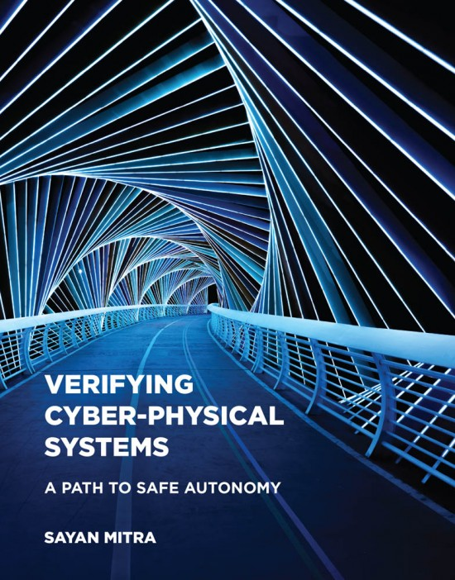
Chapter 4: Modeling Cyber-Physical Systems

Slide 3
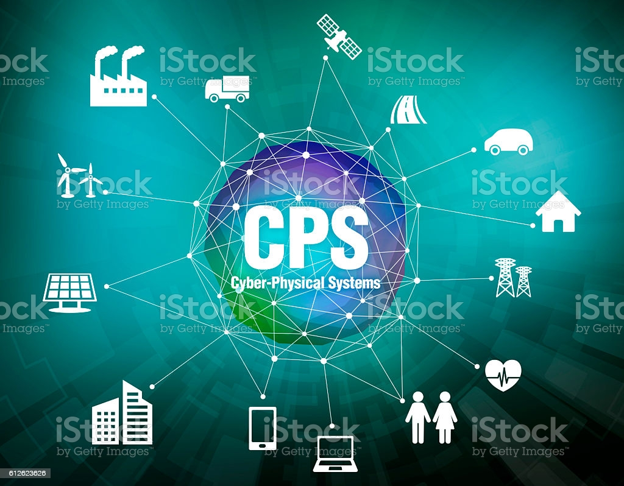
Introduction
Cyber Physical System (CPS): physical systems that are controlled by computer
Physical system modeling: ODE
Computer operation: Automata
CPS: ODE + Automata (Hybrid Automata)

Slide 4
Hybrid Automata (HA)
Why study HA?
When the two modeling paradigms collide → strange behavior happens
It is possible for an HA to perform infinitely many transitions in finite time
It is possible for an HA to become unstable even though its ODEs are stable

Slide 5
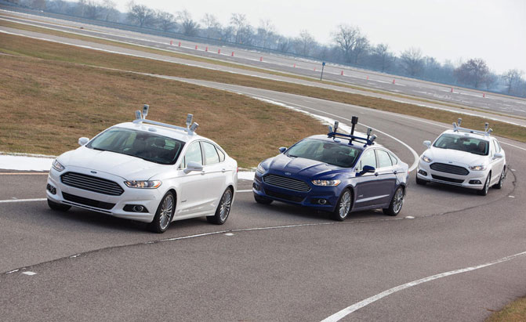
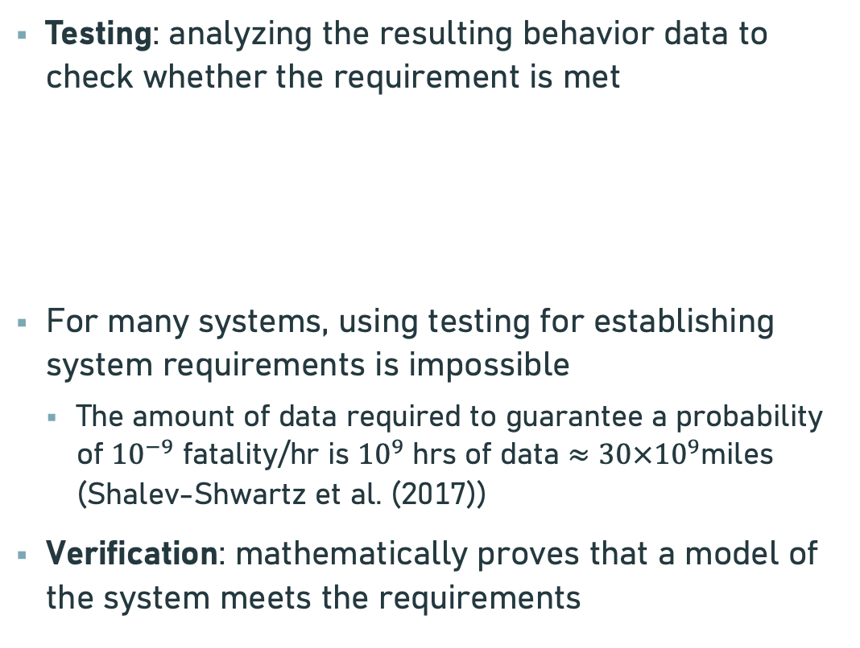
Testing Vs Verification
Testing: analyzing the resulting behavior data to check whether the requirement is met
For many systems, using testing for establishing system requirements is impossible
The amount of data required to guarantee a probability of ${10}^{−9}$ fatality/hr is ${10}^{9}$ hrs of data $≈30×{10}^{9}$miles (Shalev-Shwartz et al. (2017))
Verification: mathematically proves that a model of the system meets the requirements
Initial
condition
System
Output
Input

Slide 6
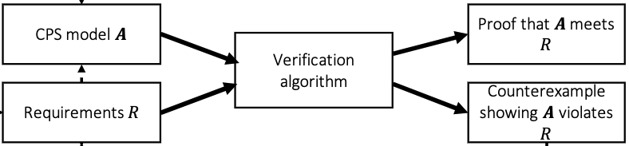
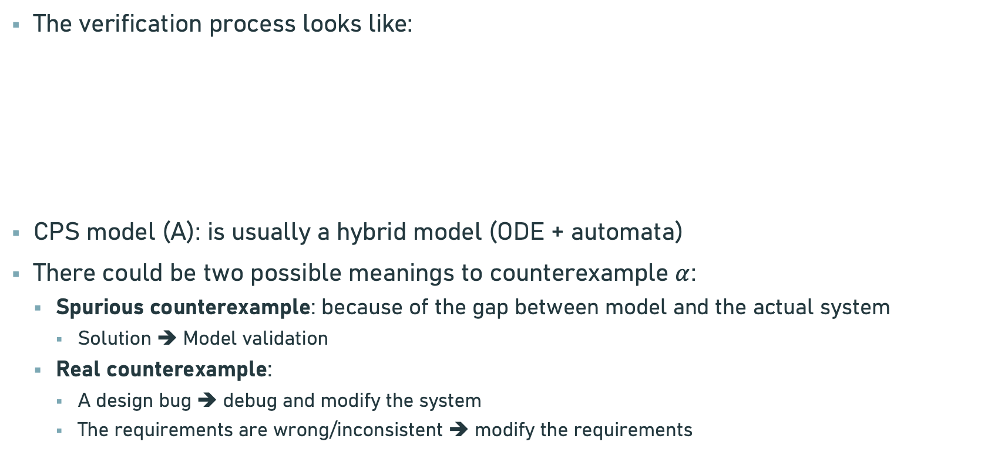
Verification
The verification process looks like:
CPS model (A): is usually a hybrid model (ODE + automata)
There could be two possible meanings to counterexample $α$:
Spurious counterexample: because of the gap between model and the actual system
Solution ➔ Model validation
Real counterexample:
A design bug ➔ debug and modify the system
The requirements are wrong/inconsistent ➔ modify the requirements

Slide 7
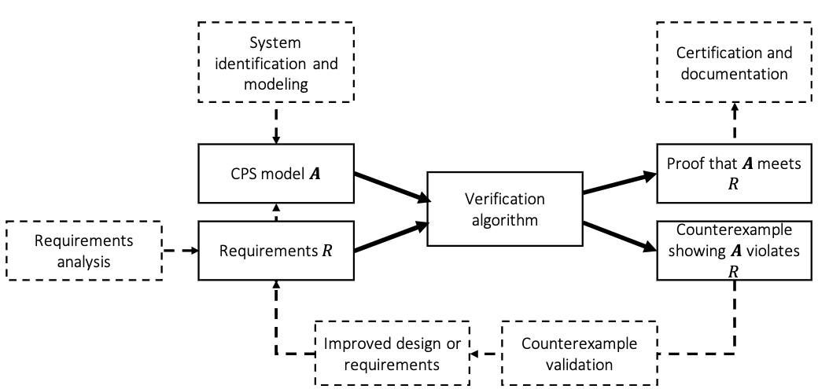
System Design Ecosystem

Slide 8
Challenges of Verification
Theoretical undecidability :
There is no algorithm that checks whether a model of CPS meets a requirement.
To address this → relaxing the verification question (e.g. bounded time horizon or tolerate some false positives)
Practical Scalability :
Lack of scalability is a huge challenge for the progress in verification
Missing Models :
Complete models of CPS systems are difficult to come by
Oftentimes models lack succinct descriptions, are distributed, and are protected intellectual property
Learning-enabled systems and missing requirements :
Recent CPS systems use DNN ➔ lack models and requirements

Slide 9
Chapter 2: MODELING COMPUTATION

Slide 10
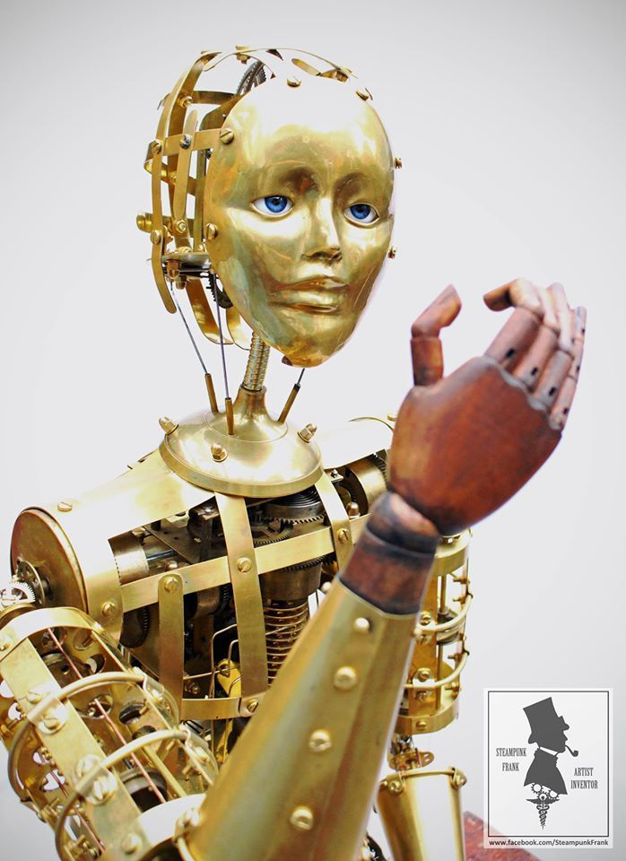
Introduction
Aim: how can we develop a mathematical model for computation
We use differential equations to model physical systems ➔ how about computation?
Automaton: 19th century word used to describe mechanical dolls
In mathematics, we use automaton to describe the rules of state change of any computational process
Aka, discrete-time transition system or a state machine

Slide 11
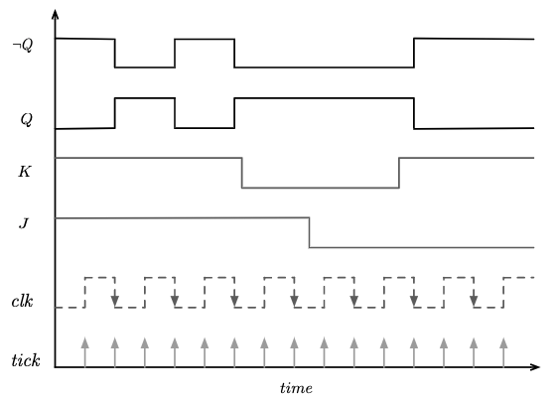
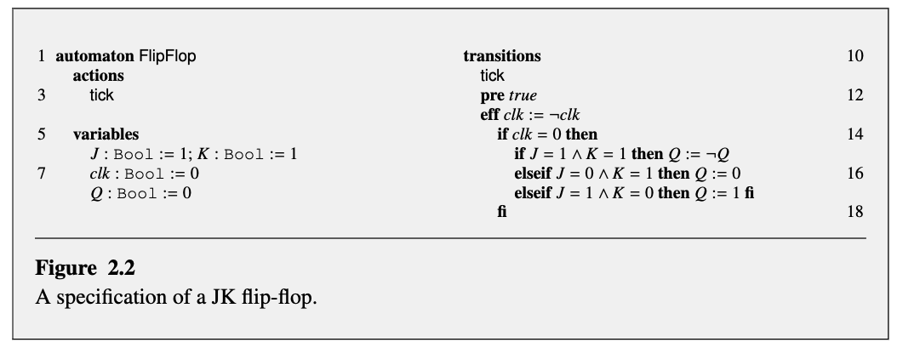
Example: JK Flip-Flop
clk | J | k | Q
0 | 0 | 0 | previous
0 | 0 | 1 | 0
0 | 1 | 0 | 1
0 | 1 | 1 | toggle
Parts of specification
Actions: lists various types of rules for state change
Variables: lists the state variables
Transitions: lists the state change rules for each of the actions

Slide 12


Specifying automata
State variables:
A state represents the information necessary for predicting the future of an automaton
Valuation:
Maps each state variable name to a value
Predicates:
A Boolean–valued formula involving the variables in V (we use it as a requirement)
For example: the state satisfies the formula
Because
Transitions:
Specify the rules for state change in a computation

Slide 13
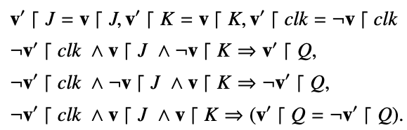

Automata
An automaton $𝓐$ is a tuple $\left(V,Θ,A,𝓓\right)$, where
V is a set of state variables and val(V) is valuations of V
$Θ⊆val(C)$ is a set of start states
A is a set of actions
$𝒟⊆val(V)×A×val(V)$ is called the set of transitions

Slide 14
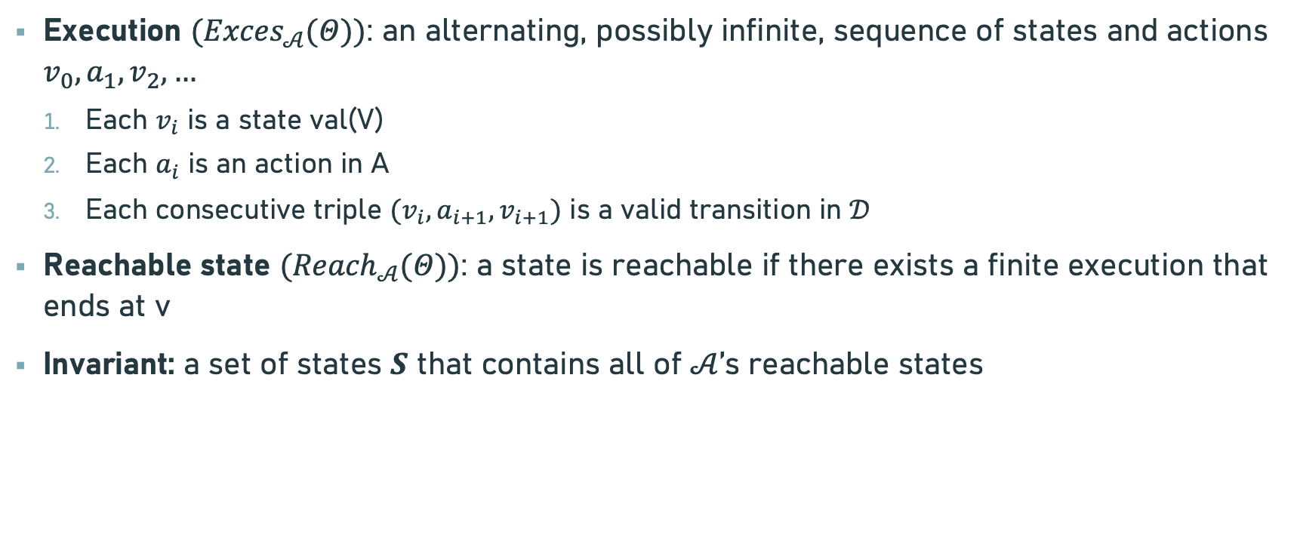
Semantics
Execution $({Exces}_{𝒜}(Θ))$: an alternating, possibly infinite, sequence of states and actions $v_{0}, a_{1}, v_{2},…$
Each $v_{i}$ is a state val(V)
Each $a_{i}$ is an action in A
Each consecutive triple $(v_{i}, a_{i+1}, v_{i+1})$ is a valid transition in $𝒟$
Reachable state $({Reach}_{𝒜}(Θ))$: a state is reachable if there exists a finite execution that ends at v
Invariant: a set of states $S$ that contains all of $𝒜$’s reachable states

Slide 15
Thank You!!!

